Slide 1





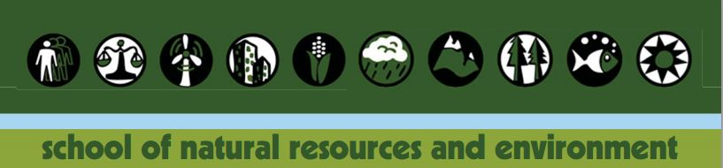
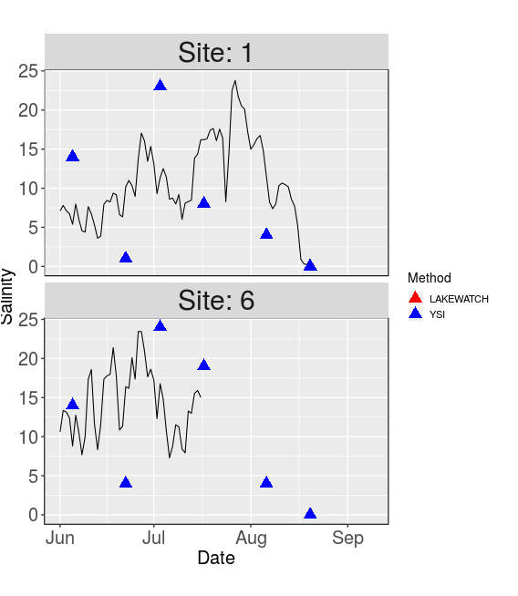
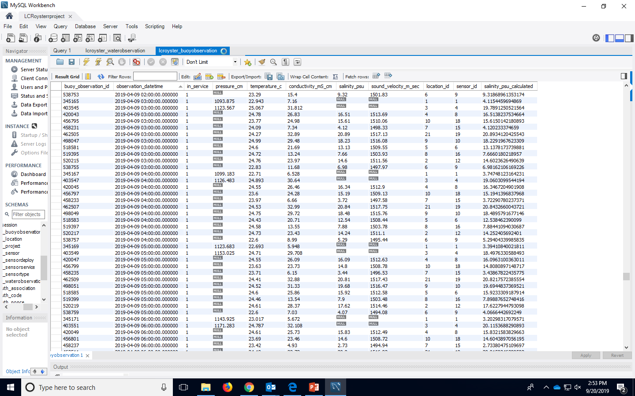
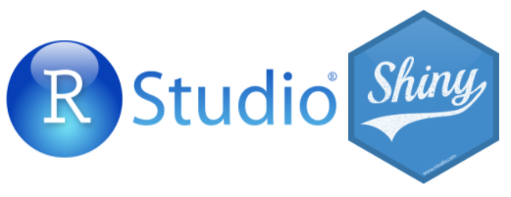
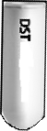
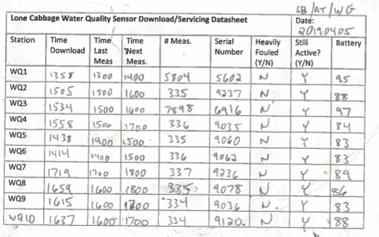
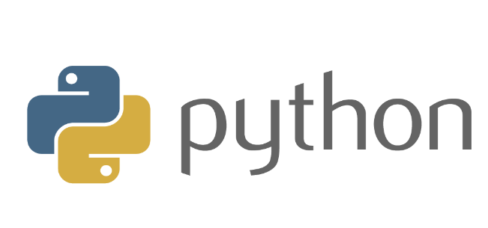
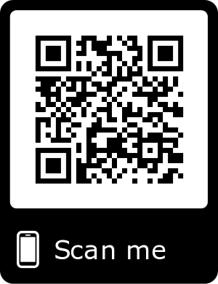
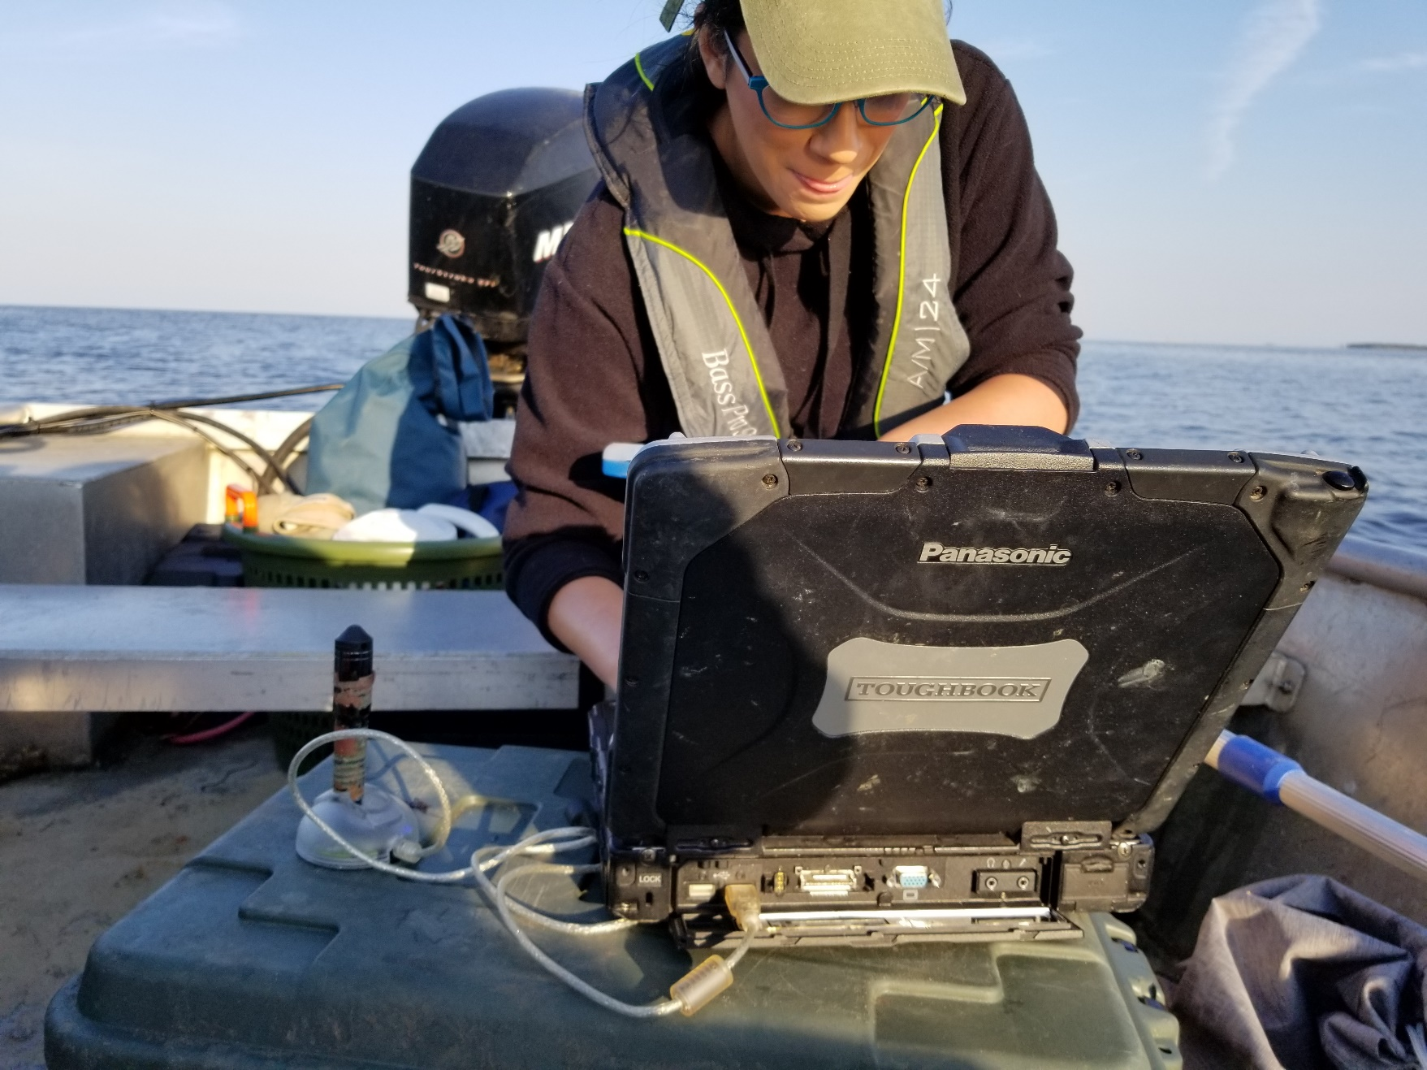
Big Changes in the Big Bend:
A Data Management Story
Authors: Melissa Moreno, Joe Aufmuth, Dr. Bill Pine
Introduction
Methodology
Interactive Shiny App
The Lone Cabbage Reef restoration project is designed to promote oyster reef recovery and promote estuarine conditions in Suwannee Sound, Florida. To evaluate the restoration data are collected on oyster populations and from a network of water quality sensors. These are “living data” which are continuously collected. We are developing a data workflow that minimizes data entry and management errors while allowing for rapid, reproducible analyses of project data to inform ongoing monitoring and restoration efforts.
Improving restoration decision-making through streamlining data workflow.
The Interactive Shiny App allows for agencies and the public to view the results of our data collection. Updates are available within 5 business days of water quality service trip.
Cycle begins
with newly
added data
Future Data Work
Acknowledgments:
Dan Maxwell - Associate University Librarian at the University of Florida
Plato Smith - Data Management Librarian at the University of Florida
Robert Phillips - Information Technologist, George A. Smathers Libraries at the University of Florida
Peter Fredrick - Research Professor in the Department of Wildlife Ecology and Conservation at the University of Florida
Steve Beck - Research Coordinator for Lone Cabbage Reef Restoration Project at the University of Florida
Sarah Meyer - Health Sciences Librarian at the University of Florida
Integration of new data types including imagery and oyster population data. Electronic field data entry using tablets. Custom R package for routine quarterly reports.

